Slide 1
Chapter -5
Cascading Style Sheets

Slide 2
*Advantages
CSS saves times – Once a style is defined we can reuse it in multiple HTML pages.
Pages Load faster- Because of less coding the HTML pages can download fast.
Easy Maintenance – If we make the changes in one element, all the similar elements in the document will be updated.
Smaller File size
Consistency – With CSS it is easy to keep consistent look through out the website.
Accessibility – It is easy to access the web pages.
Multiple Device Compatibility- Style sheets allow the contents to access in more than one type of devices.
Disadvantages
Browser Compatibility - It is not compatible with all types of web Browsers.

Slide 3
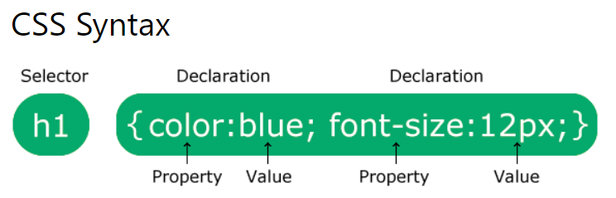
CSS Syntax
selector {property : value;}
Use only lowercase letters.
The selector: points to the HTML element you want to style.
Property :is the type property you wish to apply for the HTML element. It could be color, font-size, background, margin, border etc.
Value: It is the value of the property.

Slide 4
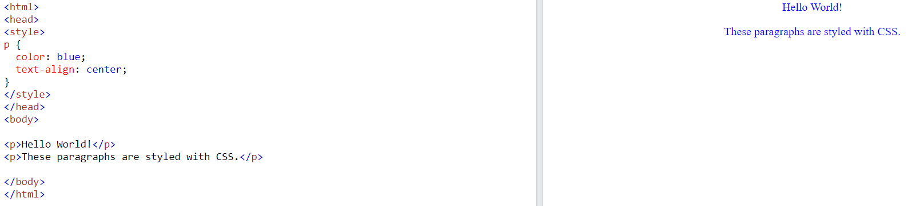

Slide 5
*CSS
CSS stands for Cascading Style Sheets.
It is a style sheet language which is used to describe the look and formatting of a document .
We can add new look and style to our document.
CSS (Cascading Style Sheets) is a style sheet language used to design the webpage to make it attractive.
It can control the layout of multiple web pages all at once.

Slide 6
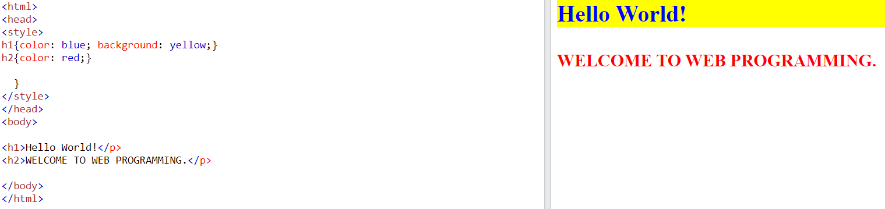

Slide 7
Multiple Selectors
Instead of writing the same CSS rule for every HTML tag we can group selectors together and separate them by Commas. This makes the coding compact & efficient.
h1,h2,h3{ color :black;}

Slide 8
**Types of CSS/ Style Specification Formats
There are three types of CSS which are given below:
Inline CSS
Internal or Document CSS
External CSS

Slide 9
Inline Styles
It is the most simplest and direct way of applying CSS to an element.
The CSS property in the body section attached with element is known as inline CSS.
Eg: <p style=“color:red”>
this is a paragraph
</p>
An inline style is used to apply a unique style for a tag which is defined for.
This kind of style is specified within an HTML tag using the style attribute. The style attribute can contain any CSS property.
We are applying the CSS property directly to the elements so a selector is not necessary.
It is defined with the <body> tag.

Slide 10
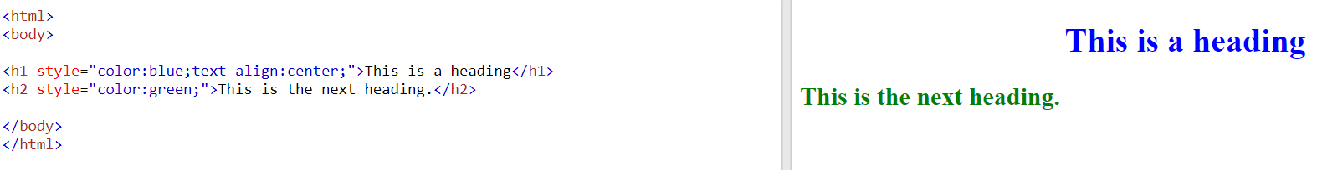

Slide 11
Internal or Document Styles
An internal style sheet is used when a single HTML page(Document) needs to be in a unique style.
Internal styles are defined within the <style> element, inside the <head> section of an HTML page.
The CSS is embedded within the head section and therefore it is also known as embedded style.

Slide 12
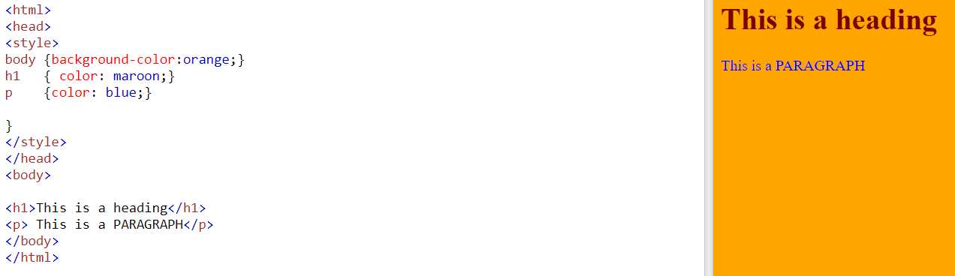

Slide 13
External Styles
An external style sheet is a separate CSS file in which the styles will be defined and that can be accessed by creating a link within the <head> section of the webpage.
The link to an external style sheet is placed within the head section of the page.
External styles are defined within the <link> element, inside the <head> section of an HTML page.
The two important attributes for the link tag is: 1. rel : It describes the relation between the actual document and the one we are linking to.
2. href :this is the link to the external style sheet

Slide 14
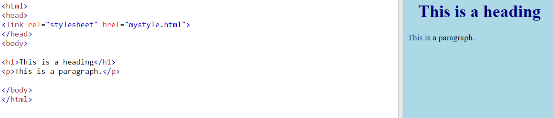

Slide 15
**Types of Selectors/ Selector Forms
Type selectors
Class Selectors
Id selectors
Descendant selectors
Child Selectors
Universal Selectors
Adjacent sibling selectors

Slide 16
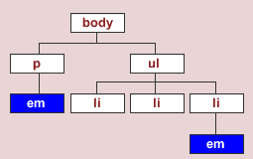
Type Selectors
Type selector will select any HTML element on a page that matches the selector, regardless of the their position in the document tree.
Eg: em {color :blue;}
This rule will select any<em> element on the page and its color it blue.

Slide 17
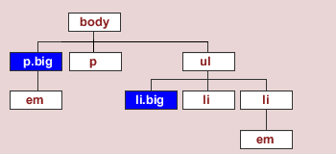
Class Selectors(.)
Class selector is used to select any XHTML element that has a class attribute , regardless of their position in the document tree.
It is used with a period character . (full stop symbol) followed by the class name.
Eg: .big {font-size : 18% ;}
In this example it will select all big attribute since it is denoted as the class attribute.

Slide 18
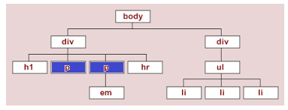
Id selectors(#)
ID selector is used to select any XHTML element that has a ID attribute , regardless of their position in the document tree.
An id attribute is indicated using pound(#) symbol.
Id selectors must be unique and it can only apply once per page.
Eg: #p { font-size : 10%;}
All the Paragraph elements will get selected as it is mentioned as the id attribute.

Slide 19
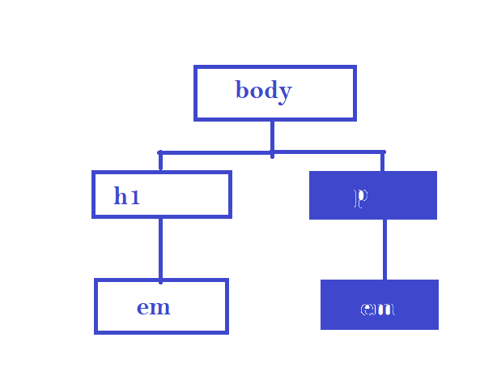
Descendant Selectors
Descendant Selectors are used to select elements that are descendants of another element in the document tree.
Eg:1
p em {color : blue;}
That means it will only select <em> elements that are descendant of <p> elements.

Slide 20
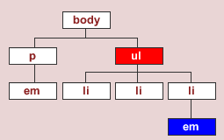
Eg 2: ul em { color :blue ;}
Will select all the em descendants of ul and color it blue.

Slide 21
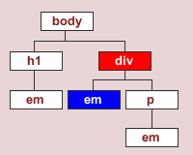
Child Selectors ( > )
Child selectors are used to select an element that is a direct child of another element(parent). Child selectors will not select all the descendants, only the direct children will get selected.
Child selector is denoted by the symbol >
Eg: div > em { color : blue ;}
Will select all the direct em child of the div tag and color it as blue.

Slide 22
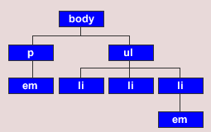
Universal Selectors(*)
The asterisk (*) is used as the CSS universal selectors.
It is used to select any and all types of elements in an HTML page. This selector is useful when we want to select all the elements on the page.
Eg: * { color : blue ;}

Slide 23
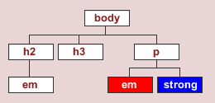
Adjacent sibling selectors(+)
It is used to select the siblings immediately following an element.
It is denoted by the symbol +
Eg: em + strong {color : blue ;}
It means that select all the strong tag that are immediately after em tag.

Slide 24
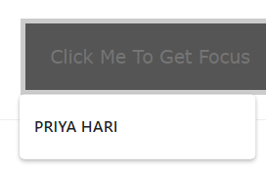



*pseudo-classes
A pseudo-class is used to define a special state of an element.
Like, it can be used to:
Style an element when a user moves the mouse over it
Style an element when it gets focus
For example, The ":hover" is used for adding special effects to an element when the user moves the cursor over the element.
The names of the pseudo-class are not case-sensitive.

Slide 25
The widely used pseudo classes are as follows:
:hover: It adds special effects to an element when the user moves the mouse pointer over the element.
:active: It is used to add style to an active element.
:link: It adds style to the unvisited
link:visited :It adds style to a visited link.
:lang :It is used to define a language to use in a specified element.
:focus: It selects the element which is focused by the user currently.

Slide 26
*Font Properties
The CSS font property is used to set the font’s content of the HTML element.
The types of font properties in CSS are:
font-family
font-style
font-weight
font-variant
font-size

Slide 27
font-family
We use the font-family property to specify the font of a text.
The font-family property is used for rendering text similar to the fonts we select in Word processors. To change the font we can use font-family property.
There are two types of font- family names:
family-name - The name of a font-family, like "times new roman", "courier", "arial", etc.
generic-family - The name of a generic-family, like "serif", "sans-serif", "cursive", "fantasy", "monospace".

Slide 28
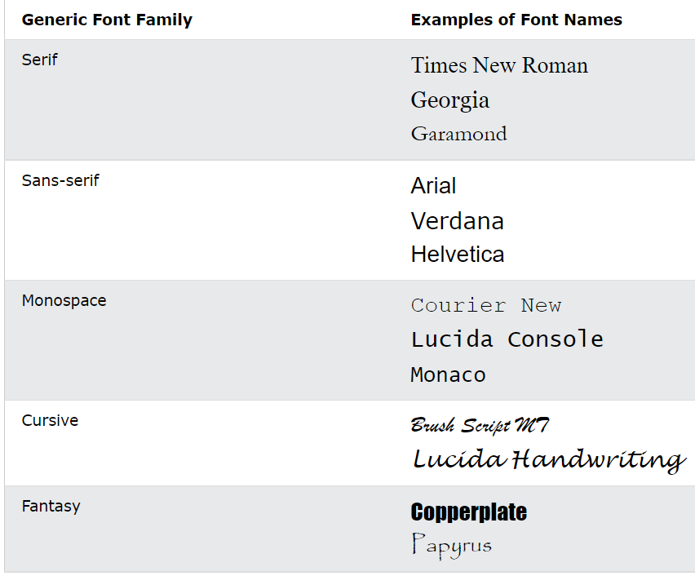

Slide 29
font-style
The font-style property specifies the font style for a text. Like
It can be “normal, italic or oblique”.
Font-style property has three values:
→normal - The text is shown normally
→italic - The text is shown in italics
→oblique - The text is "leaning" (oblique is very similar to italic)
CSS Syntax
font-style: normal|italic|oblique

Slide 30
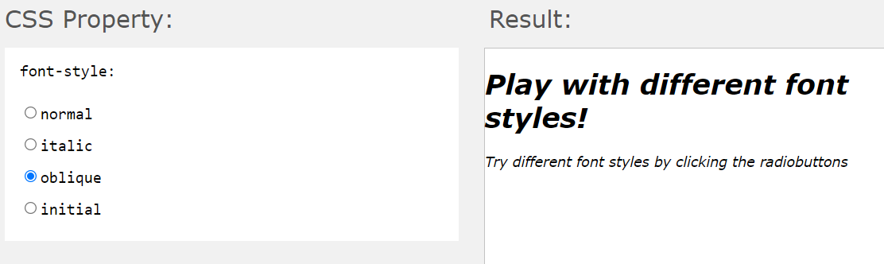

Slide 31
font-weight
The font-weight property sets how thick or thin characters in text should be displayed.
Font weight can go from 100 to 900.
Where 900 is the thickest font.
We can also specify ‘bold’ ,’bolder’, or ‘normal’
Eg: p {font-weight :900;}
p {font-weight :normal;}

Slide 32
Font-variant
The font-variant property specifies whether or not a text should be displayed in a small-caps font.
Small Caps means all the letters will be displayed in the capital letters but the font size is smaller than usual.

Slide 33
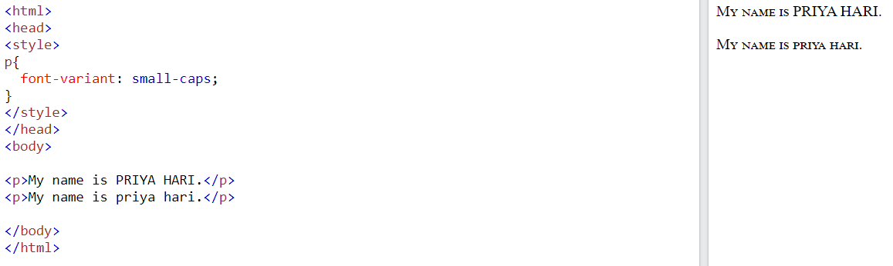

Slide 34
Font-size
The font-size property is used to set the size of the text.
The font-size can be set in different ways like in “pixels, percentage, em or we can set values like small, large” etc.
Eg1: using pixel
p {font-size: 40px; }
Eg2: using em
p {font-size: 2.5 em; }
Eg:3: using percentage
p {font-size: 100%; }

Slide 35
**Text Properties
CSS text formatting properties is used to format text and style text.
CSS text formatting include following properties: 1.Text-color 2.Text-alignment 3.Text-decoration 4.Text-transformation 5.Text-indentation

Slide 36
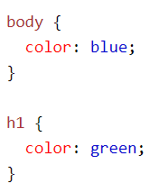
Text-color
The color property is used to set the color of the text. The color is specified by:
a color name - like “blue"
a HEX value - like "#ff0000“
Eg:

Slide 37
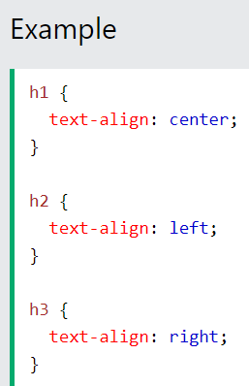
Text Alignment
The text-align property is used to set the horizontal alignment of a text.
A text can be aligned left or right, center, or justify.

Slide 38
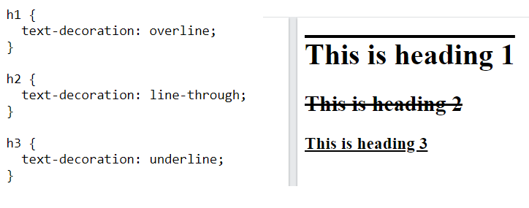
Text Decoration
Text decoration is used to add or remove decorations from the text.
Text decoration can be underline, overline, line-through or none.

Slide 39
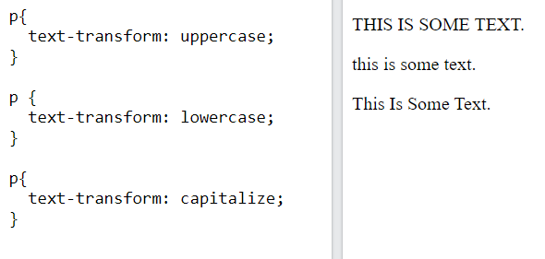
Text transformation
Text transformation property is used to change the case of text, uppercase or lowercase.
Text transformation can be uppercase, lowercase or capitalize .
Capitalize is used to change the first letter of each word to uppercase.

Slide 40
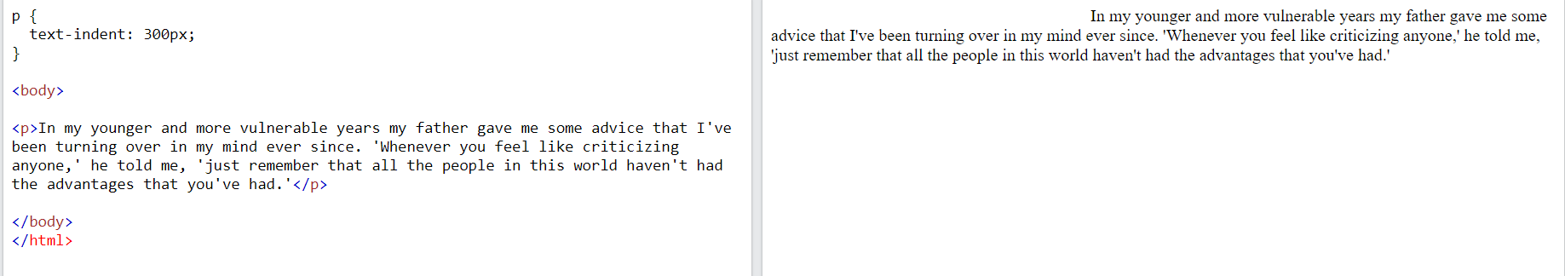
Text Indentation
The text-indent property is used to specify the indentation of the first line of a text.

Slide 41
List properties
In HTML, there are two main types of lists:
unordered lists (<ul>) - the list items are marked with bullets
ordered lists (<ol>) - the list items are marked with numbers or letters
The CSS list properties allow us to:
Set different list item markers(numbers) for ordered lists
Set different list item markers (bullets)for unordered lists
Set an image as the list item marker

Slide 42
list-style-type
The list-style-type property specifies the type of list item marker.
Eg: ul { list-style-type: circle; } ul { list-style-type: square;

Slide 43
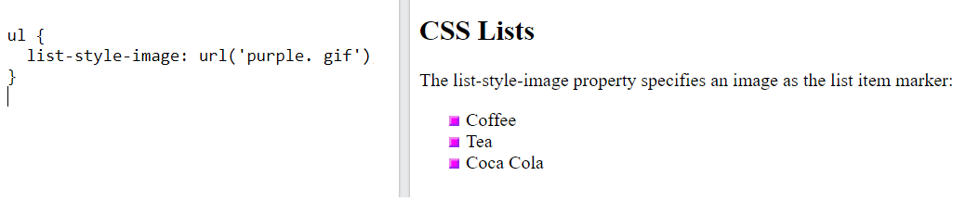
list-style-image
The list-style-image property specifies an image as the list item marker.

Slide 44
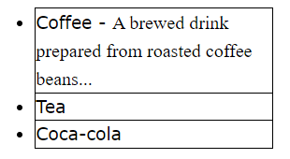
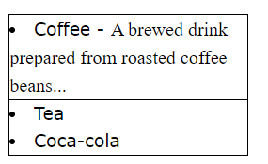
list-style-position
The list-style-position property specifies the position of the list-item markers (bullet points).
"list-style-position: outside;" means that the bullet points will be outside the list item.
"list-style-position: inside;" means that the bullet points will be inside the list item.

Slide 45
*Color Properties
The color property is used to specify the color of text or an element.
To provide the color we can use the different color formats.

Slide 46
Color formats
FORMAT | SYNTAX | EXAMPLE
HEXCODE A hexadecimal is a 6 digit representation of a color. The first two digits (RR) represent a red value, next two represents green(GG), the last two digits is blue (BB)and the hexcode will be preceeded by a # sign. | #RRGGBB | P{ color : #ffffff ;}
SHORT HEXCODE This is a shorter form of the six digit notation. It will use 3 digit to represent the color code. In this each digit is replaced with an equivalent value. Eg: #6A7 becomes #66AA77 | #RGB | P{ color : #6B7;}
KEYWORD In this we directly use the color name. | Aqua ,black etc. | P{color :orange;}

Slide 47
Color Groups
Color | Hexcode
RED | #ff0000
MAROON | #800000
WHITE | #ffffff
BLACK | #000000
SILVER | #c0c0c0
GREY | #808080
BLUE | #0000ff
GREEN | #008000

Slide 48
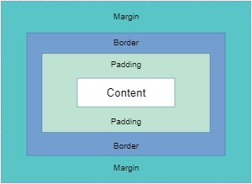
**CSS BOX MODEL

Slide 49
The CSS box model is essentially a box that wraps around every HTML element.
It is used to develop the design and structure of a web page.
It provides the best design and layout for web pages.
The web browser renders every element as a rectangular box according to the CSS box model.

Slide 50
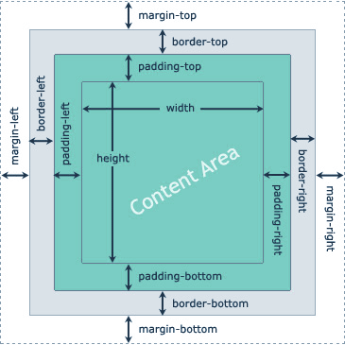
Parts of the CSS Box Model
It consists of:
Margin
Border
Padding
Content Area

Slide 51
Content Area
The innermost part of the box is the content area, which is used to insert the elements such as “<h1>”,”<ul>”,”<p>”…etc.
The width and height property defines the width and height area.
This area consists of contents like text, image, or other media content.
Material such as text, photographs, or other digital media can also be included in this area.

Slide 52
Padding Area
It is an area around the content.
It is defined as the space around the content area and the border.
This area is actually the space around the content area and within the border box.
Its dimensions are given by the width of the padding-box and the height of the padding-box.
This width and height is specified as left padding , right padding, top and bottom padding

Slide 53
Border
Border field is a region between the padding-box and the margin.
A border that goes around the padding and margin.
The middle layer in the box model is the element’s border.

Slide 54
Margin
The space just outside the border is margin.
The margin is completely invisible.
It is useful to separate the element from its neighbors.
Margin also define as left , right , top and bottom

Slide 55
** <div> and <span> Tags
<div> - The div tag is known as Division tag.
The div tag is used in HTML to make divisions of content in the web page.
div tag has both open(<div>) and closing (</div>) tag and it is mandatory to close the tag.
The div is the most usable tag in web development because it helps us to separate out data in the web page and we can create a particular section for particular data or function in the web pages.
Any sort of content can be put inside the <div> tag!

Slide 56
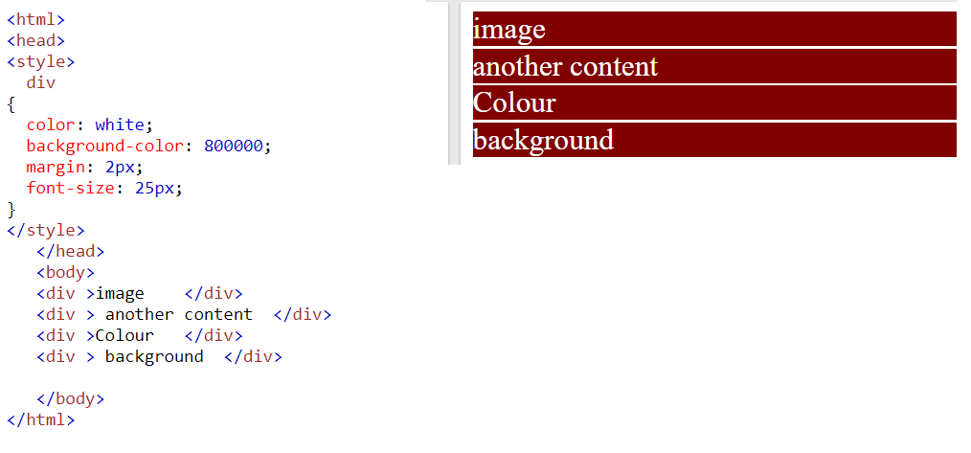

Slide 57
*<span> tag is used to group elements for styling purposes.
<span> is much similar as <div> tag, but <div> is used for block-level elements and <span> tag is used for inline elements.
The <span> tag can be useful for the following task:
To change the language of a part of the text.
To change the color, font, background of a part of text using CSS.
The <span> element shows the inline portion of a document. The <div> elements show a block-level portion of a document.

Slide 58
